Slide 1
Zowe Overview
Zowe™, the Zowe™ logo, and the Open Mainframe Project™ are trademarks of The Linux® Foundation

Slide 2
Agenda
Zowe Overview
LTS Release
Conformance Program
Enterprise and Production Ready
Get involved
Q/A

Slide 3
Zowe Overview
Presenter name / title

Slide 4
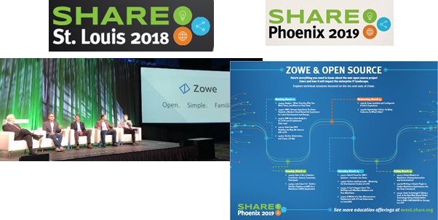

What is Zowe?
First ever mainframe open source project
Hosted by the Linux Foundation, Open Mainframe Project
Eclipse Public License - v 2.0
Announced at SHARE August 2018
1.0 GA released February 2019
Initial Contributors: Broadcom, IBM, and Rocket Software
Offers open, modern, standardized platform for mainframe applications
Notes:
[reworked to make this more exciting]

Slide 5
Zowe Defined
An integrated and extensible open source ecosystem for z/OS with a coherent and curated set of user and programmatic interfaces that:
Provide consistent access to z/OS systems and services
Leverage industry standard methodologies and standards familiar to the vast majority of developers
Are commonly accepted as a mainframe community standard
Notes:
Add this as a build – clean up and add visual

Slide 6
Zowe Deliverables
Components Include:
4 Active
2 Incubation
Packaged: as a binary download
Includes: a set of applications built on top of the framework
Delivers: a cloud-like integration experience
Goal: Unify IT infrastructure & application delivery
Notes:
Add this as a build – clean up and add visual

Slide 7




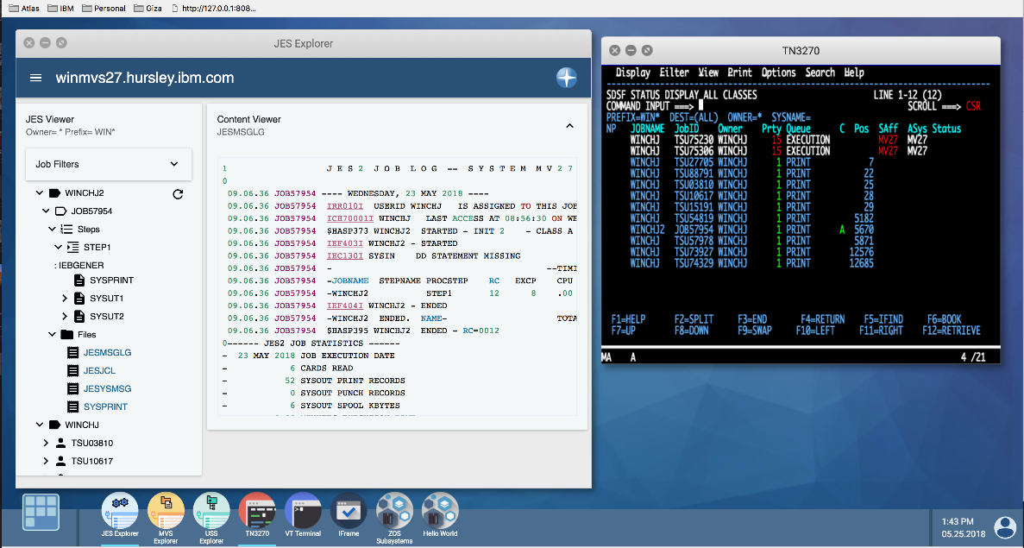
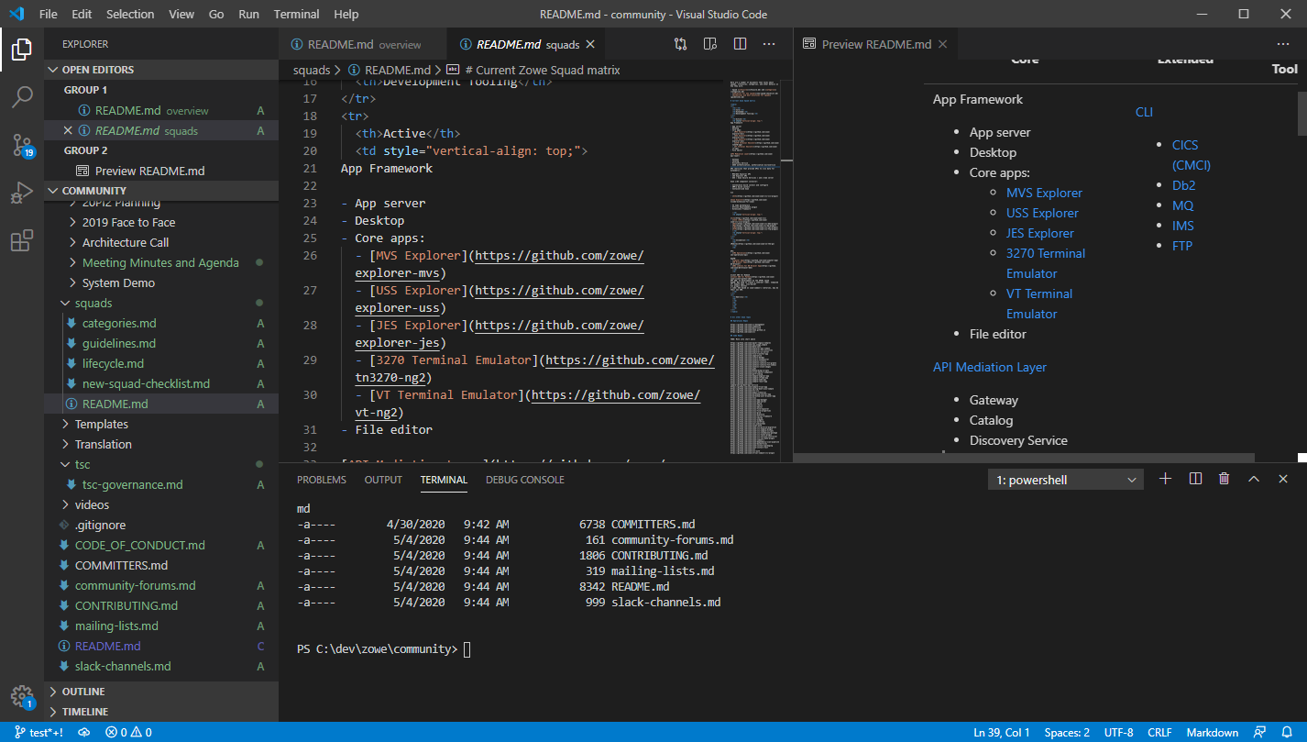

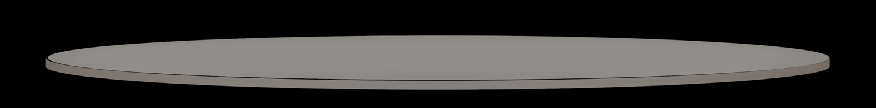
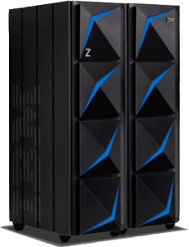
Zowe Active Components
Ravi (DevOps)
Michelle (App Dev)
Tyler (Sys Admin)
Isabelle (Operator)
CODE
DEPLOY
PLAN
Plugins
BUILD
RELEASE
Plugins
OPERATE
TEST
MONITOR
CLI: build | deploy
Explorer
Application Framework
API Mediation Layer
Microservices
Notes:
API Mediation Layer and Microservices present access to many z/OS and z/OS subsystem services in an easy-to-manage and consume manner which is highly scalable. Ease of use features are SSO and swagger-based API documentation, browser, and tester
Click+1: One of the Zowe sub-systems that interfaces with the APIML is the CLI – blah blah blah
Click+2: Another Zowe sub-system that interfaces with APIML is Explorer – blah blah blah
Click+3: Another Zowe sub-system that interfaces with APIML is App Framework – blah blah blah
Click+4: The end-users of Zowe through these sub-systems are DevOps engineers, app developers, sysprogs, and operators
Click+5: All these come with built-in extensions for example to interface with special APIs (e.g. CICS-specific CLI commands) or desktop apps (e.g. 3270 emulator)
Click+6: Users and developers can also define their own extensions and interface them with existing microservices or new microservices they create
Click+7: Finally, users can invoke APIs through the APIML directly
In closing, what you see on this slide is what you get today when you download the Zowe binary from Zowe.org

Slide 8
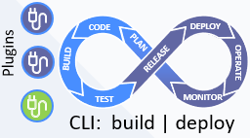
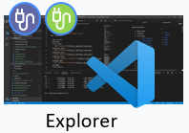
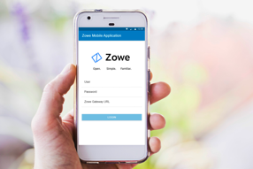
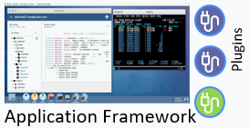


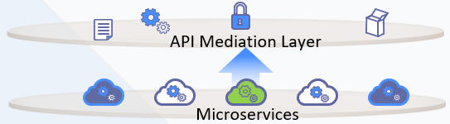
Zowe with incubation projects
Ravi (DevOps)
Michelle (App Dev)
Tyler (Sys Admin)
Isabelle (Operator)
Zowe Mobile App (Incubation*)
Packages
Client Zowe SDK (Incubation*)
* Incubation sub-projects are research and
prototypes not ready for general consumption
** Extensibility of Zowe Explorer is in development
Notes:
However, there is more going on in Zowe today. Two additional projects are in incubation stage. These are available today to evaluate and to contribute to but they are not included in the binary download. One has to download the sources and build them yourself to try them out.
Blah blah blah

Slide 9
Zowe Future Direction
Ravi (DevOps)
Michelle (App Dev)
Tyler (Sys Admin)
Isabelle (Operator)
Zowe Mobile App (Incubation*)
Client Zowe SDK (Incubation*)
Packages
* Incubation sub-projects are research and
prototypes not ready for general consumption
** Extensibility of Zowe Explorer is in development
Notes:
..more on future architecture direction based on incubating projects…

Slide 10
LTS Release Overview
Presenter name, title

Slide 11
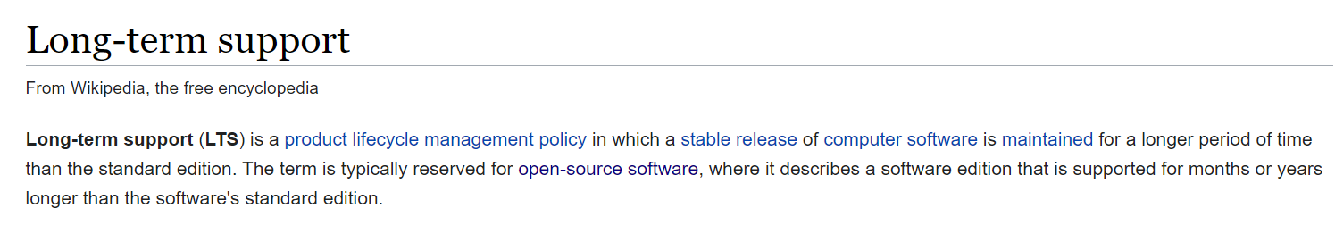
Why LTS?
Long-term support release
Address Critical Mainframe-centric Client Expectations
Security
Stability
Interoperability
Feature Deprecation Advanced Notice
Dependable Support Timeline

Slide 12
Zowe LTS Release Policies
New (LTS) version introduction timeline
Community determined at the beginning of each calendar year
CURRENT Designation (~6 – 9 months)
“Current” signifies “cutting edge” release status
May not be “stable”, i.e. (most-likely) includes breaking-changes
Available to Zowe consumers for early test, feedback and adjustments
ACTIVE and MAINTENANCE (LTS) Designations (~24 months total)
“Active LTS” signifies ready for general use, continuous release delivery
Occurs after CURRENT
Releases may contain fixes and enhancements
Duration may vary
“Maintenance LTS” signifies ready for general use, continuous release delivery
Occurs after ACTIVE
Releases contain ONLY fixes

Slide 13
Additional LTS Considerations
A Long-term Support Release:
Is effectively, the combination of Active + Maintenance designated time periods
Provides two guarantees:
Critical* defects will be fixed (*critical defect is defined at zowe.org)
The LTS-established, required Conformance Criteria will not change
Extenders who achieve Zowe conformance for the long-term support version will not need to modify their product (extension) to ensure interoperability with the Zowe distributions offered throughout the life of the long-term support version
Will remain supported for at least 24 months
Is the release designation recommended for Production application use
Extender products remain functional
Community committed to fix critical defects
Notes:
Combine with previous slide

Slide 14
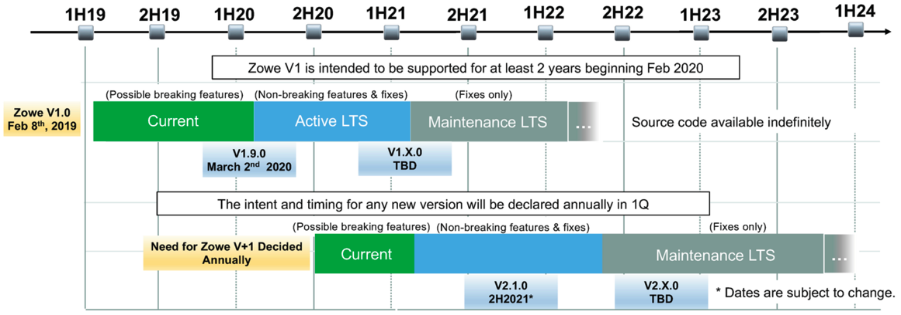
LTS Release Schedule
Active LTS
14

Slide 15
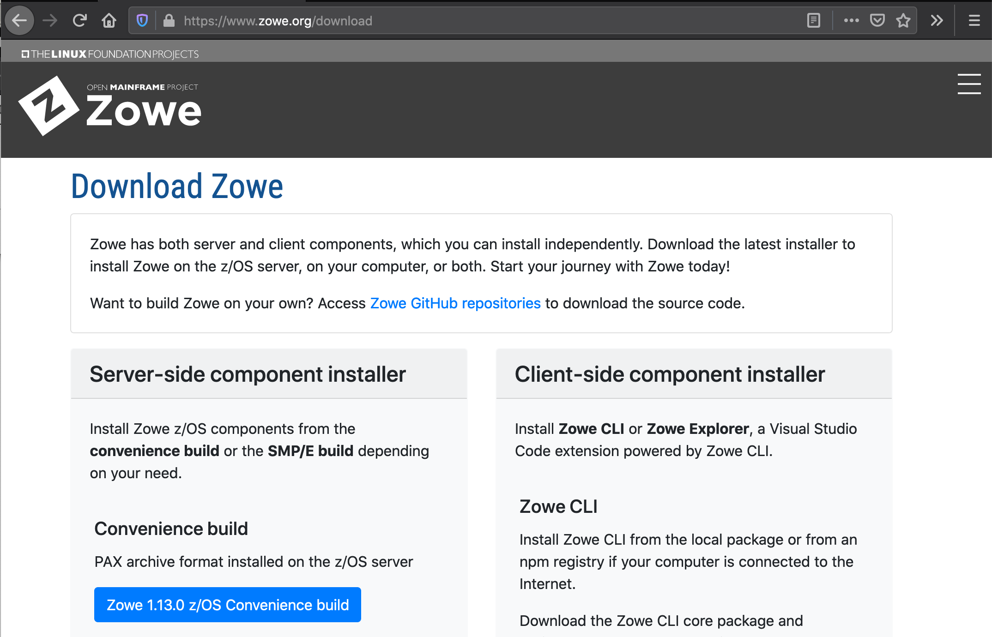
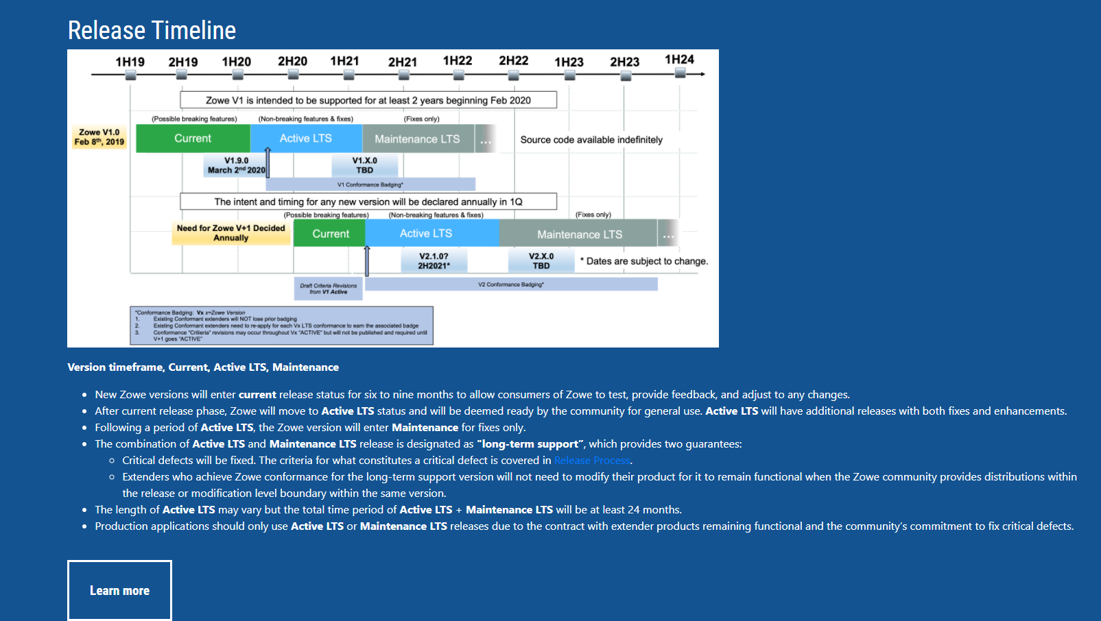
LTS additional information
Notes:
Fix red circle ;-)
FIXED both!

Slide 16
V1 LTS Key Deliverable: Packaging and install
We want the same customer experience
regardless of the source of the code
“Vendor Neutral Package”
for Single Zowe Instance
NOW
Vendor Distribution 1
Zowe.org
Convenience Build
(Zowe release)
Pax file format
SMP/E format
Future releases=PTFs
Vendor Distribution 1
Vendor Distribution 1
Special Squad Established
CUPIDS = Componentized Update Package Install Distribute and Service
“Smarter” install
Components installed, selectively configured and activated using a “PARMLIB Model”
More flexible start options
Hash Code Verification
Next Steps
Portable Software Instance
Containers
Customer z/OS LPAR
Single Zowe instance
Optional Additional Zowe instances
Optional Additional Zowe instances

Slide 17
Zowe Conformance Program
Presenter name / title

Slide 18

What is Conformance?
Zowe can be used “as delivered” or through plugins and extensions created by clients or 3rd-party vendors
Optional program developed by Zowe community directed towards “extenders”
Guidelines / minimum requirements
Technology Quality Gate
Earned “stamp” of approval
Notes:
The Zowe Conformance Program was developed by the the Zowe community as a means to ensure that each plug-in and extension associated with a given Zowe component has met a minimum set of requirements that enable them to deliver common functionality, interoperability, as well as a common user experience
Zowe Badging permits use of ZOWE Symbol.

Slide 19
Why Conformance?
Common functionality
Flexibility, Integration, Interoperability
Encourage, Improve Quality
Consistent User Experience
Benefits the PROVIDERS and the CONSUMERS
Notes:
The Zowe Conformance Program was developed by the the Zowe community as a means to ensure that each plug-in and extension associated with a given Zowe component has met a minimum set of requirements that enable them to deliver common functionality, interoperability, as well as a common user experience
As an EXTENDER of Zowe Conformant Applications:
Ensures my application will behave as designed in the Zowe ecosystem
Helps me to maximize the value of my application
Helps to ensure that other applications will NOT break mine
Demonstrates thought leadership / partnership
Allows me to market my application using the Zowe brand
As a CONSUMER of Zowe Conformant Applications:
Allows me to leverage a common stack of infrastructure across multiple vendor applications
Provides a level of operational confidence thru transparency
Offer the collective “quality assurance” of the community. i.e. all conformant applications have been vetted by the community

Slide 20
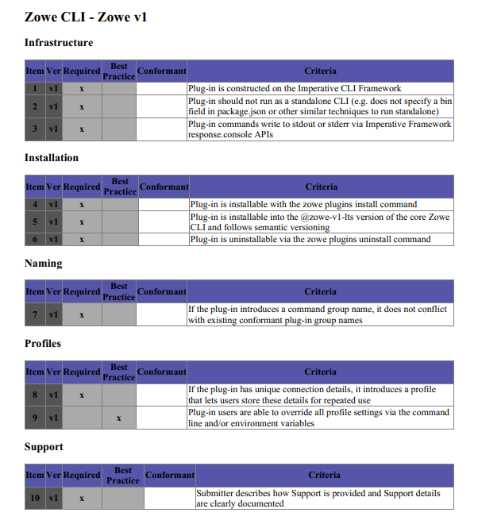
Updates for Zowe Conformance ZOWE V1
Program Updates from Zowe Conformance 2019
Base version for conformance revised to Zowe 1.9 (initial Active LTS release)
Test Criteria transitioned to checklist format and entries “tagged” with “LTS” #
Program material transparency / maintained openly on Open Mainframe Project Github
Terms and Conditions modified to retain previous program revision badges
Ongoing Continuous Improvement
Community feedback and participation on Zowe Conformant requirements
Web Page / App Store look-and-feel
Incremental badge considerations

Slide 21
Anyone can apply for Zowe Conformance
Participate in the Zowe Conformance Program
Eligable Conformant Offerings
New Apps
Existing / 2019 Conformant Apps
4 Steps to Conformance:
https://www.openmainframeproject.org/projects/zowe/conformance
PREPARE Review program and test evaluation guide(s)
TEST Confirm “required” entries are satisfied
SUBMIT Email your “official” request
REVIEW OMP reviews / approves / notifies / issues badges
Review Program Terms and Conditions
Complete Test Evaluation Guide
Submit Participation Form

Slide 22
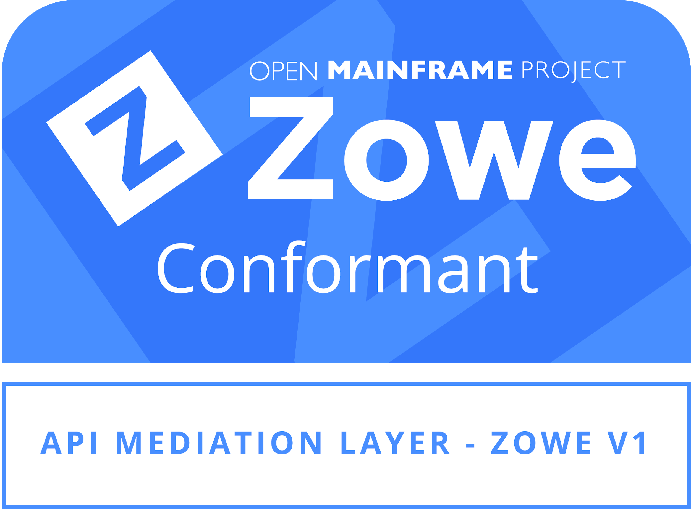
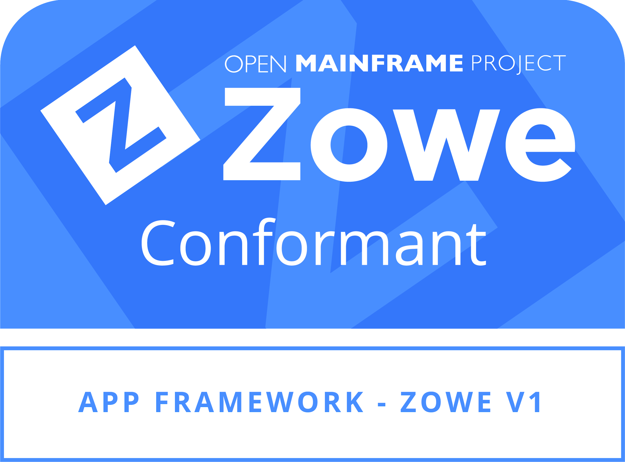
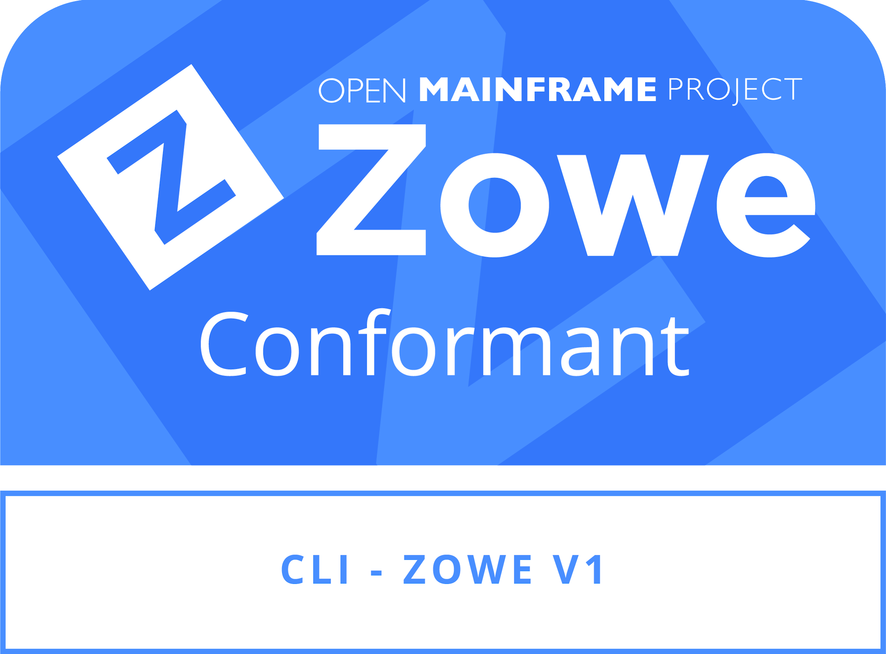
Zowe Conformance Terms
Both new and previous Zowe Conformant offerings are eligible for Zowe V1.
Program fees apply
Waived for current Open Mainframe Project members
Open Mainframe Project staff will independently and objectively review all submissions in confidence
Zowe community members may be contacted for questions, but the identity of a submitting organization or individual will not be disclosed
Upon approval, Open Mainframe Project staff will notify the submitter and communicate on badging and publication of offering
Notes:
4 Steps to CONFORMANCE:
Prepare: Review the program and the test evaluation guide(s)
Test: Follow the instructions for testing your application and submit your request
Submit: Submit your official request
Review: Your request will be reviewed and approved, your application will be “badged”
OMP reviews all applications
Vendor neutral
Ensure competitor confidentiality
Approves and posts terms and conditions
Un-biased assessment
Zowe Community
Determines, presents, and maintains the conformance criteria
Test Evaluation Guides
Terms and Conditions
Zowe Conformance Program
Manages “use of” Zowe Brand and Zowe Marks

Slide 23
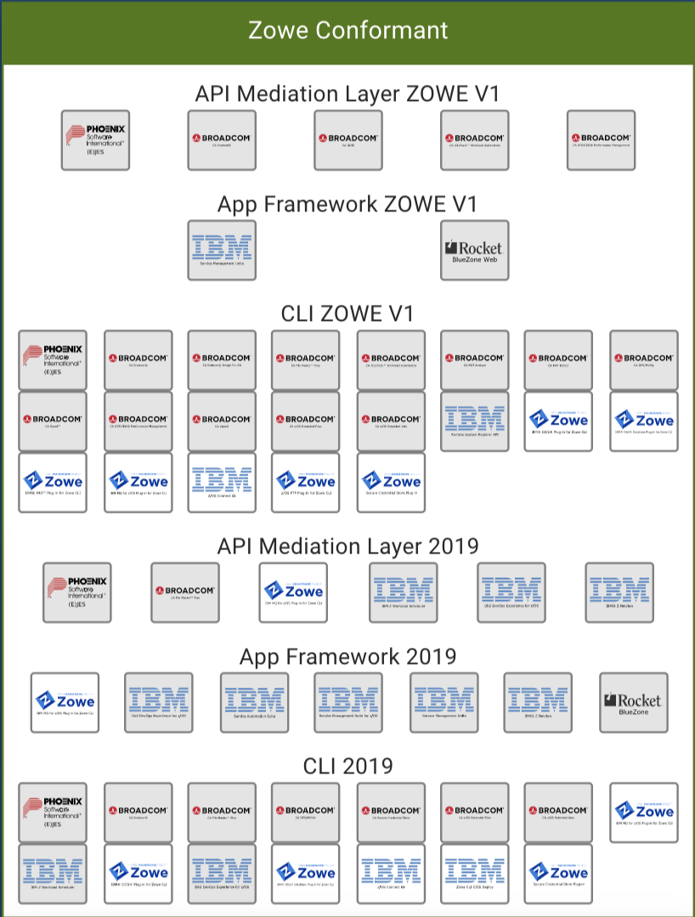
Current Zowe Conformant offerings Full List
Notes:
Explore how to make list better ( remove groupings and duplicates )

Slide 24
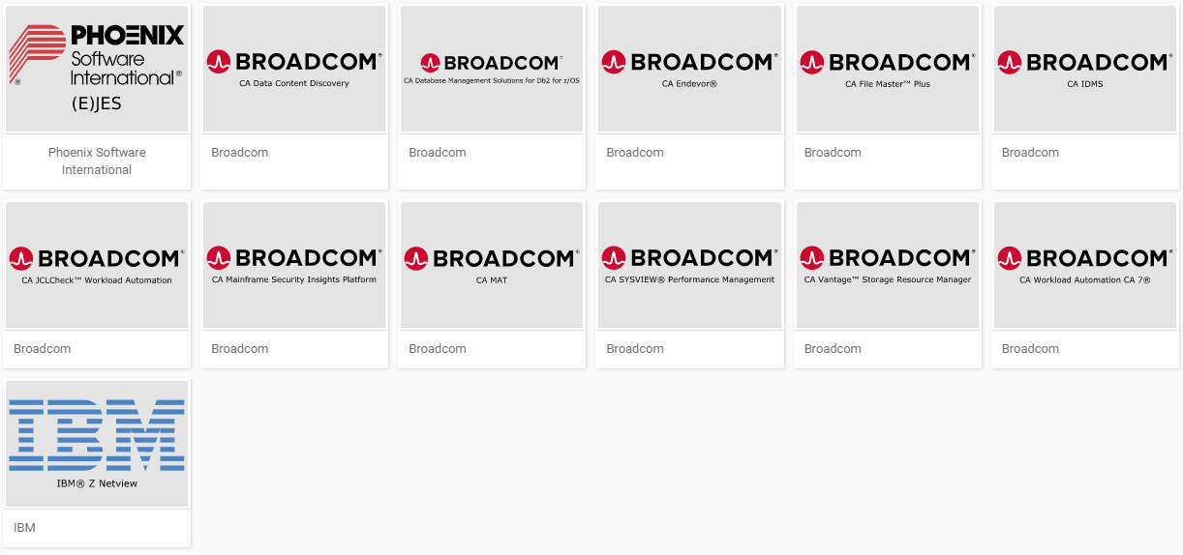
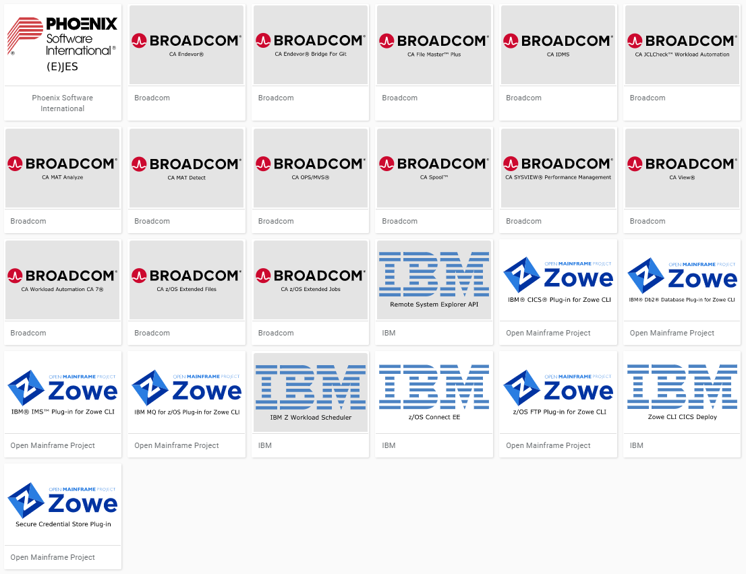
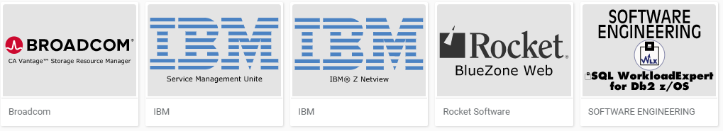
Zowe V1 Conformant Apps
13
25
API Mediation Layer
Command Line Interface
5
App Framework

Slide 25
Zowe Conformance Assistance
Are you building service APIs?
Are you planning a Zowe Web UI Plugin?
Are you planning a Zowe CLI Plugin?
Be sure you can achieve
Zowe V1 Conformance!
Tips for achieving Day 1 Conformance:
Review the conformance program details now
Print the Test Criteria Guide
Include all “required” entries in your (technical) plans
Target a “submit-for-conformance” date
Contact OMP or #Zowe Onboarding (Slack Channel) for assistance

Slide 26
Enterprise and Production Ready
Presenter name / title

Slide 27
Readiness Expectations
Tenants of Enterprise and Producion-Ready:
Is secure from intruders and respects role-based security access
Will meet “high availability” standards, i.e. continue to function, uninterrupted during service periods and backend outages
Will automatically scale to meet peaks and dips in demand
Is sustainable, supported, can be maintained and managed in a traditional mainframe software manner
Themes
Security
Resilience/Scaling
Serviceability
Notes:
[RAS] Not sure where we’re going with this “TODO” entry… I modified the section beneath to read better
Further slides expands on each point
Call out vendor support

Slide 28
Readiness Characteristics
Increasing number of Zowe Downloads
Customer-built, Production solutions leveraging core Zowe components
Growing list of Vendor offerings foundationally built on Zowe
Growing list of Zowe Conformant Plug-ins and Extensions
Availability of Zowe Support Offerings
Notes:
Reworked this slide (prior verbiage is listed below) - I think this is the sentiment we wanted to achieve right?
The success of Zowe rests on
Customers and offerings built on top of Zowe to service, support, and trust Zowe as an enterprise ready platform to deploy and use
Vendor offerings built on top of Zowe to drive footprint and grow Zowe surface area

Slide 29
Security Capabilities
SSO (single sign-on) Support
All Zowe components
Interactive
API support via JWT tokens
TLS1.2+/HTTPS Support
All Zowe components
End-to-end
SAF-based Access
All Zowe components
Comprehensive ESM coverage (i.e. includes RACF, Top Secret, and ACF2)
MFA (multi-factor authentication) Support
All Zowe components
RBAC (role-based access) Support
Application Framework
API calls and arguments supporting RBAC checks for plug-ins
File system security for RBAC meta-data
Notes:
[RAS] reformatted to better call out each feature

Slide 30
Resilience / Scalability Capabilities
Inherent Stateless Design
API Mediation Layer
Command Line Interface
Sysplex State Synchronization
Application Framework (planned)
Failover
Application Framework (planned)
Docker container support
All Zowe z/OS Components* (planned)
* Accepting ZSS micro services
Notes:
[reworked to match prior]

Slide 31
Serviceability Capabilities
Long Term Support Release
Introduced V1 LTSR @ Zowe 1.9, for all Zowe components
Includes Active and Maintenance Support Streams
See LTSR
Revised z/OS Component Delivery
Standard SMP
See CUPIDS
API Support for Log Viewing and Dynamically Set Log Trace Level
Application Framework
Command Line Interface

Slide 32
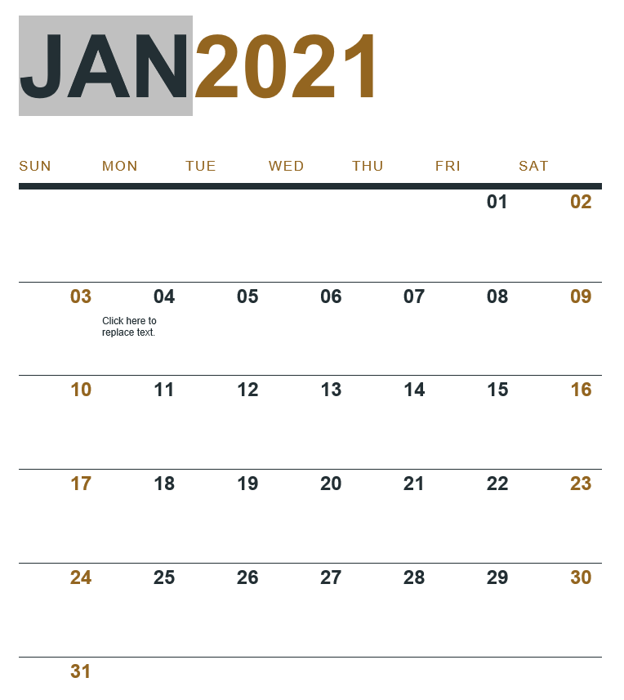
Ongoing Commitments
Join us for our next Zowe PI (Program Increment) Planning!
21PI1 Jan27-29
Join any of our meetings:
OMP Calendar: https://lists.openmainframeproject.org/calendar
Calendar URL: https://lists.openmainframeproject.org/g/zowe-dev/ics/3109196/317992940/feed.ics
Current PI Ends

Slide 33
Open Source Benefits
Presenter name / title

Slide 34
The Power of Open
Zowe fosters and leverages the collective intelligence of the community:
12,000+ contributions
5 million lines of code
35 product extensions
20,000+ component downloads (Zowe Explorer)
Complete transparency
Vendor agnostic

Slide 35
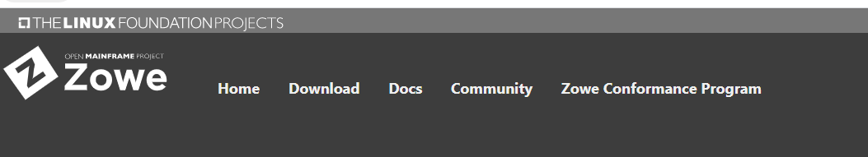
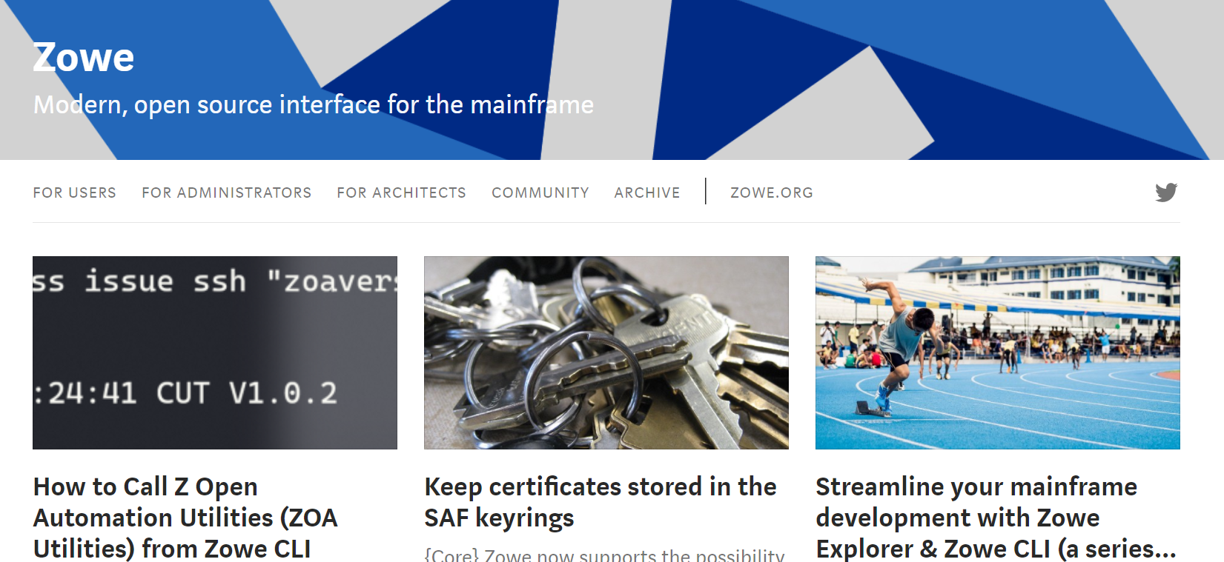
Learn, Install, Extend Zowe
HTTPS://Zowe.Org
HTTPS://Medium.com/Zowe

Slide 36
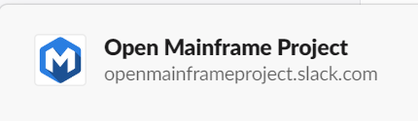
Engage with us!
Popular Channels:
# general
# zowe-onboarding
#zowe-user
#zowe-cli
#zowe-explorer
#zowe-api
#zowe-doc
Notes:
Openmainframeproject.slack.com
Onboarding channel is a great place to start!

Slide 37
Zowe as a part of the Open Mainframe Project
Presenter name / title

Slide 38






A Few Ways to Participate
Subscribe to Open Mainframe Project Mailing Lists | Attend Upcoming Mainframe Events | Get the latest development updates from the technical communities
Engage in the discussion on Slack | Start or join a local Open Mainframe Meetup | Participate in the Forums

Slide 39
Mission of the Open Mainframe Project:
Build community and adoption of Open Source on the mainframe
Eliminating barriers to Open Source adoption on the mainframe
Demonstrating value of the mainframe on technical and business levels
Strengthening collaboration points and resources for the community to thrive

Slide 40
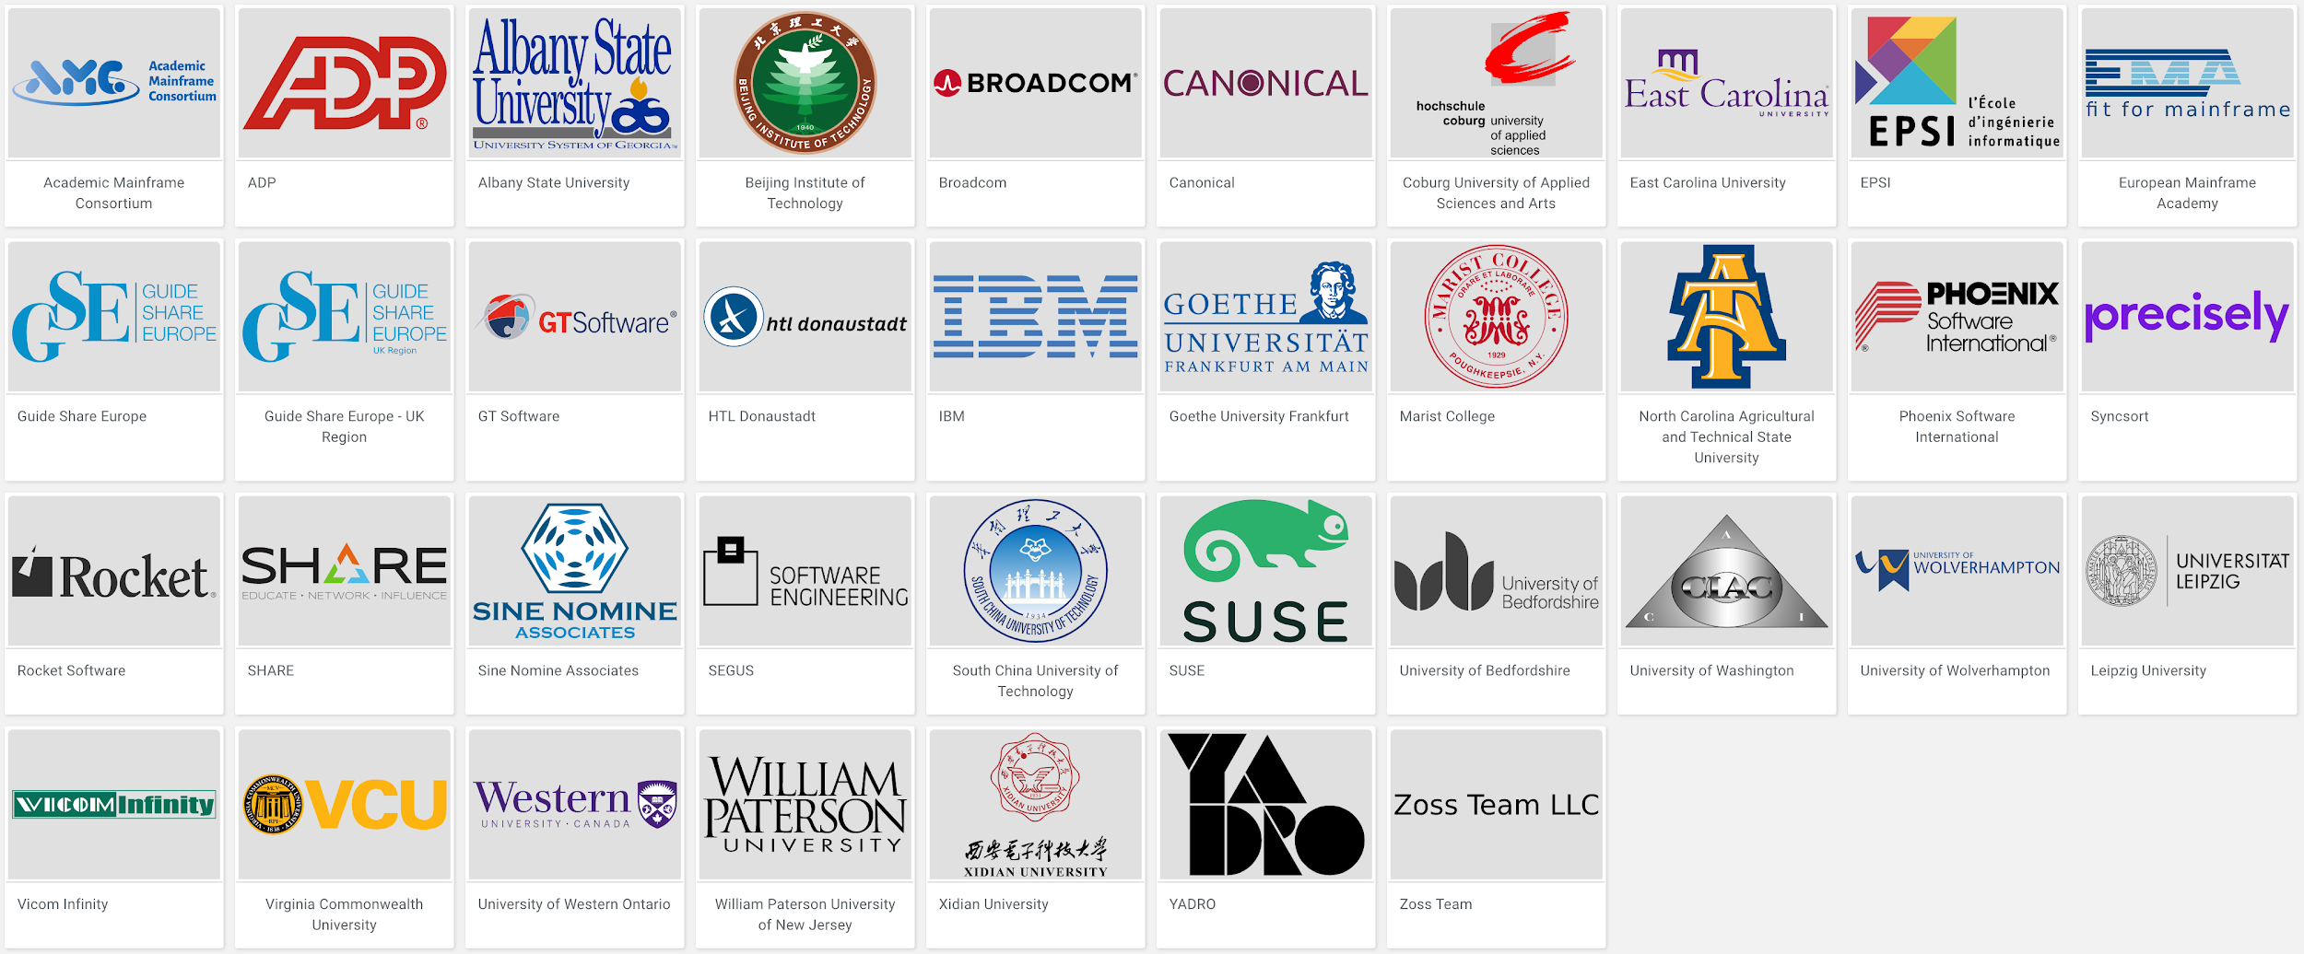
Open Mainframe Project Momentum
5 years since launch | 37 Supporting Organizations | 12 Hosted Projects | 40+ Mentees Sponsored | 100+ Students Impacted | 200+ Project Contributors

Slide 41










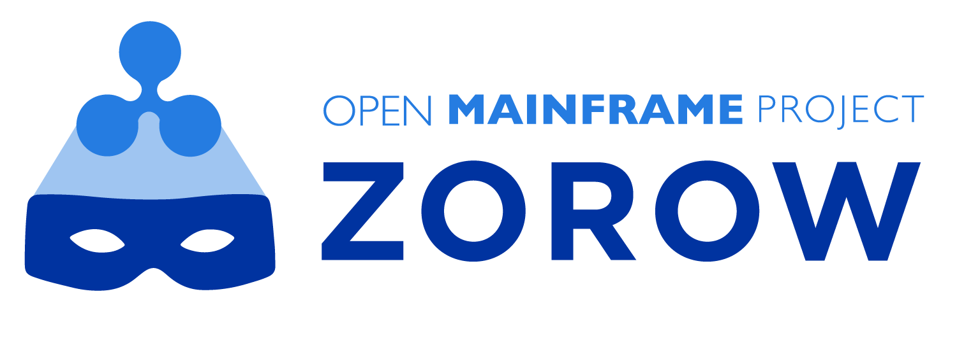
Mainframe-centric projects hosted
Active Projects
Incubation Projects
Learn about all Open Mainframe projects at https://www.openmainframeproject.org/projects

Slide 42
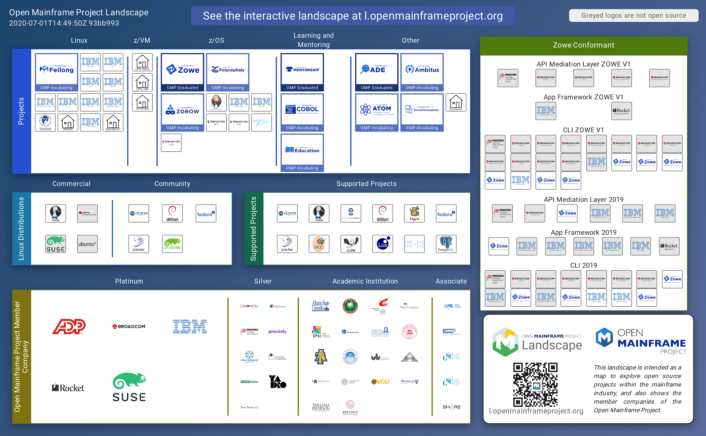
Showcasing the commercial ecosystem building from Open Mainframe Project hosted projects
Supporting a strong open source ecosystem on mainframe is crucial to sustainability. The Open Mainframe Landscape is key to identifying and understanding the dynamics.
Visit https://l.openmainframeproject.org to learn more.

Slide 43


Make sure you are follow us on social!
Follow us on LinkedIn at https://www.linkedin.com/company/the-open-mainframe-project
Follow us on Twitter at https://twitter.com/OpenMFProject

Slide 44
Questions?

Slide 45
Thank you!
@openmfproject

